Slide 1
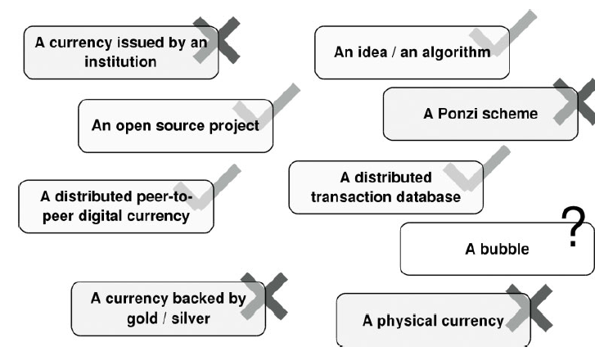

What is Bitcoin? :
Bitcoin is decentralized digital currency

Slide 2
Bitcoin
Bitcoin consists of:
A decentralized peer-to-peer network
A public transaction ledger
A set of rules for independent transaction validation and currency Issuance
A mechanism for reaching global decentralized consensus on the valid blockchain
The open source implementation
Both the source code and cimpiled libraries can be freely downloaded from
https://bitcoin.org/en/download

Slide 3
Bitcoin Core gives you increased Security and privacy at a cost. You need to take responsibility for the security of your bitcoins, meet higher minimum system requirements, and beware of some possible problems.
Minimum requirements:
Disk space: 350 GB
Download :500 MB/day (15 GB/month)(* Plus a one-time 340 GB
download the first time you start Bitcoin Core
Upload :5 GB/day (150 GB/month)
Memory(RAM) :1 GB
No matter what Bitcoin software you use, you should never buy more bitcoins than you can afford to lose. bitcoins remain a risky investment.

Slide 4

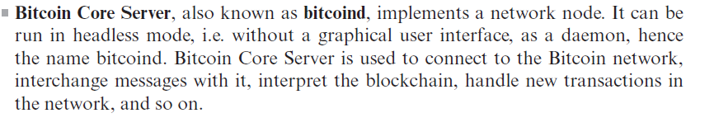
Bitcoin is single Program but includes two different services:

Slide 5
How to decentralize?
What is being decentralized?
What level of decentralization required?
What blockchain is used?
What Security mechanism is used?
Ex:
Money transfer system
Disintermediation
Bitcoin
Atomicity

Slide 6
Platforms for decentralization:
Ethereum
Maidsafe
Lisk
EOS etc…

Slide 7
Distributed Consensus:
The process of attaining the agreement on a common state or value among multiple nodes despite the failure of some nodes is known as Distributed Consensus
Various requirements for a consensus mechanism:
Agreement: All honest nodes decide on the same value
Integrity: No node can make the decision more than once in a single consensus cycle.
Validity: The value agreed upon by all honest nodes must be the same as the initial value proposed by at least one honest node.
Fault tolerant: The consensus algorithm should be able to run correctly in the presence of faulty or malicious nodes
Termination : All honest nodes terminate the execution of the consensus process and eventually reach a decision

Slide 8
Distributed Consensus:
The process of attaining the agreement on a common state or value among multiple nodes despite the failure of some nodes is known as Distributed Consensus
Various requirements for a consensus mechanism:
Agreement
Integrity
Validity:
Fault tolerant
Termination

Slide 9
The key reasons why distributed consensus is essential in blockchain:
Decentralization and Trustlessness
Immutability and Security
Ensuring Agreement
Preventing Double Spending
Network Resilience

Slide 10
Consensus algorithm
Here's a simplified version of consensus algorithm for Bitcoin:
When Alice wants to pay Bob, she creates a transaction and broadcasts it to all of the nodes.
Each node is constantly listening to the network and collecting a list of transactions not yet inserted into the blockchain.
At some point, one of these nodes is chosen randomly to propose the next block. It will put in the new block a bunch of transaction and add it to the blockchain. This node can be honest, or malicious and try to insert some invalid transactions. For example it could insert transaction with non-valid signature or with coins already spent.
The other nodes will accept this block or reject it, by either including the hash of this latest block in their next block or ignoring it. The block is accepted only if all the transaction in it are valid.

Slide 11
Types of consensus mechanisms in Blockchain:
1. Proof-based consensus mechanisms
2. Traditional fault tolerance-based

Slide 12
Types of consensus mechanisms in Blockchain:
Proof of Work(PoW)
Proof of Stake (PoS)

